Slide 1


F & B
Insights
By – kartik Gupta
Code Basics Project

Slide 2
Process
1
Data Understanding
2
Data Cleaning
3
Data Modelling
4
Data Analysis
5
Key Insights

Slide 3


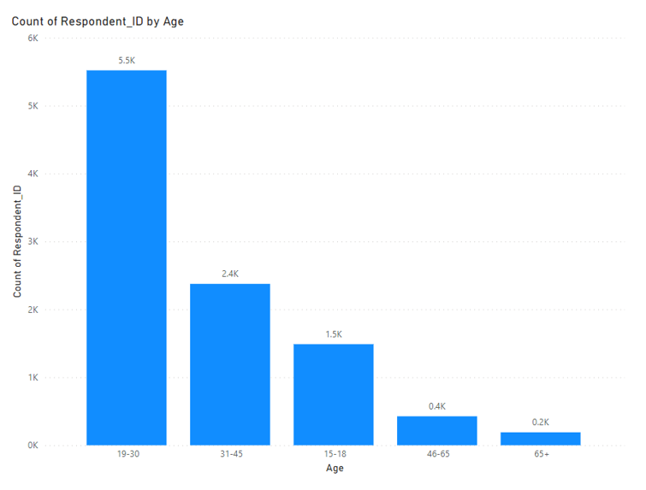
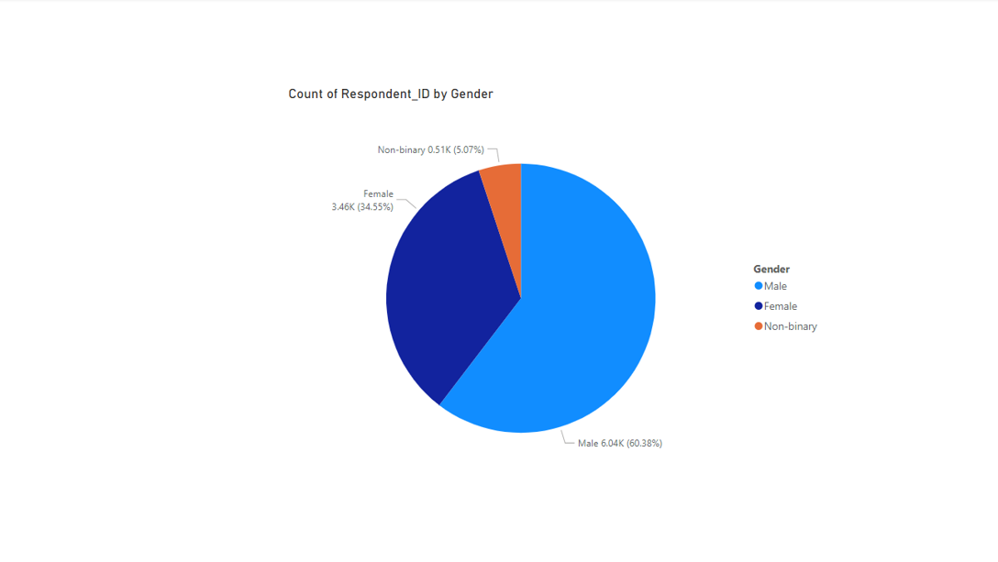
Demographics insights
60% of the consumers are male who prefer energy drinks more.
More than 50% of the respondents belong to the Age Group 19-30.
If we look at overall young age groups from 15 to 30, then the % will rise to 70%.

Slide 4
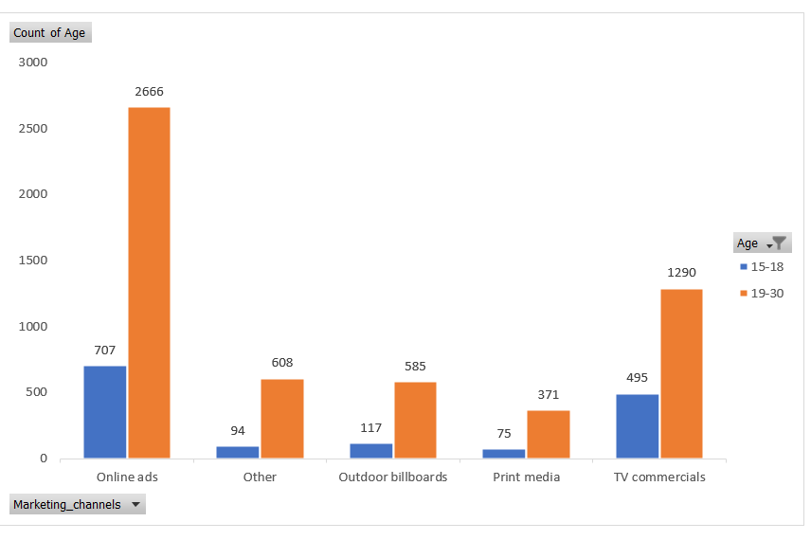
Demographics insights
Online Ads are the most effective channel that reached 3373 respondents Age group 15-30.

Slide 5
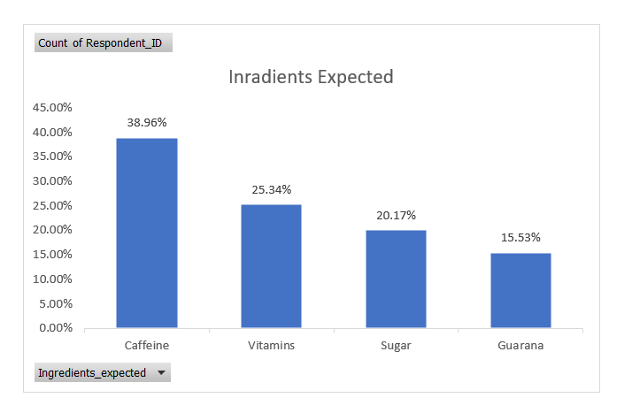
Consumer Preference
Caffeine is the most expected ingredient followed by the Vitamins in energy drinks..

Slide 6
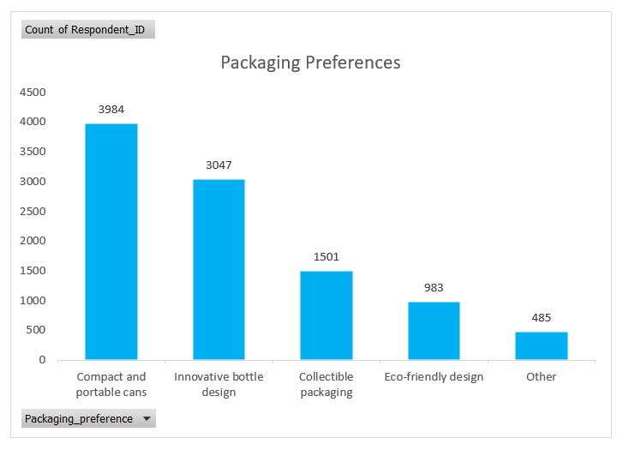
Consumer Preference
Compact & Portable Cans are high in demand followed by Innovative Bottle Designs.

Slide 7
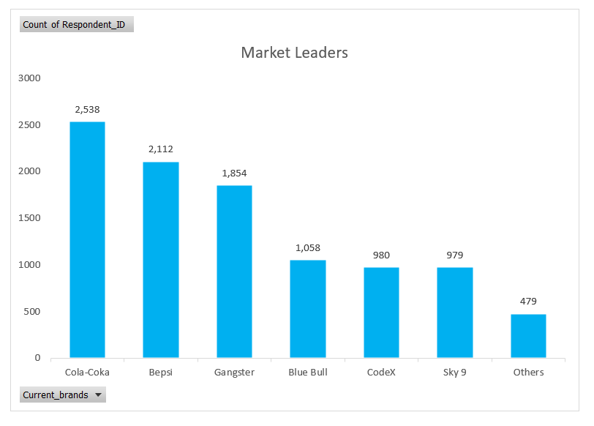
Competition Analysis
Cola Coka is leading the market followed by Bepsi.

Slide 8
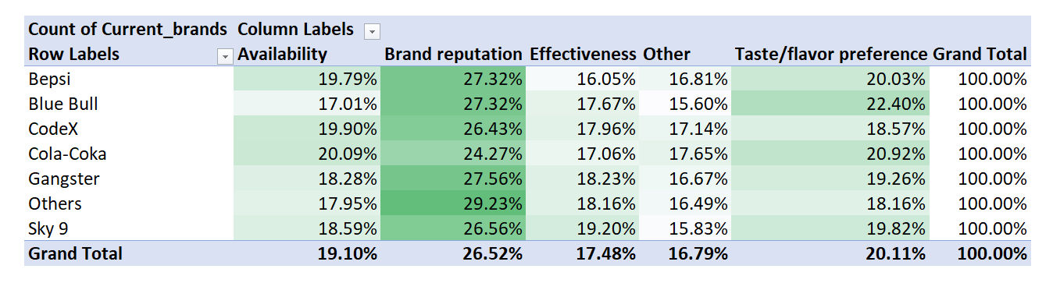
Competition Analysis
The top reason for choosing the brands by consumers is brand reputation.

Slide 9
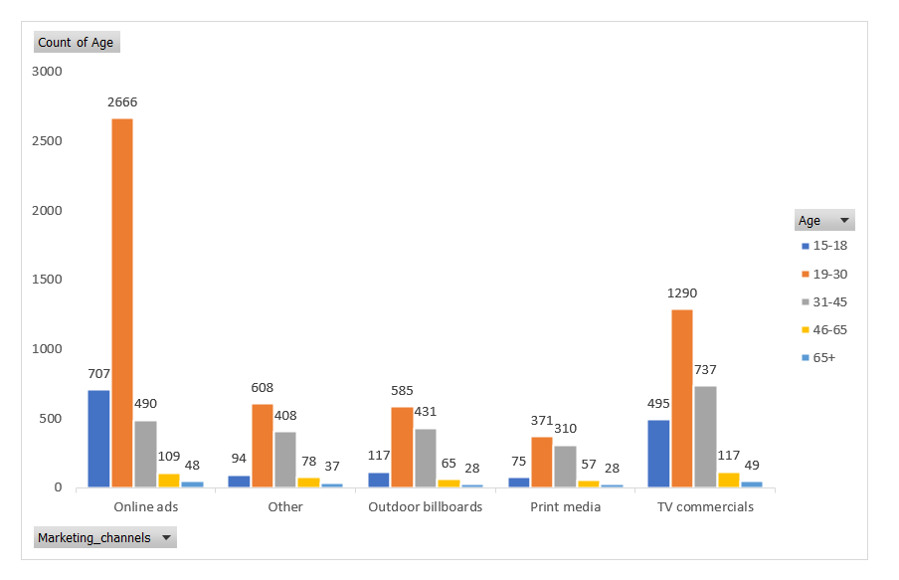
Marketing Channels and Brand Awareness
Online Ads are the most effective way to reach maximum audiences in a short duration & it is cost effective as well..

Slide 10
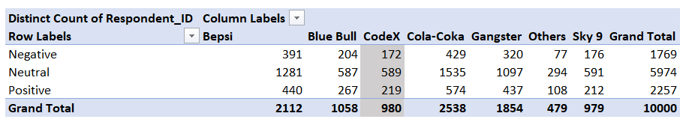
Brand Penetration
Out of 980 respondent for Codex , negative feedback is by 172

Slide 11
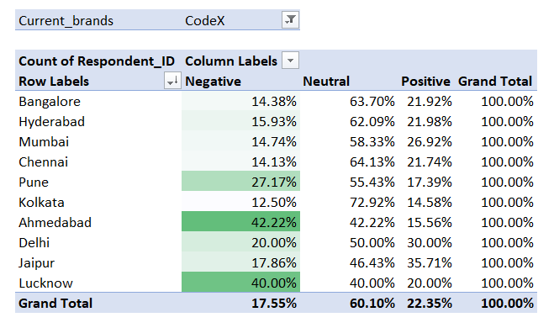
Brand Penetration
Need to focus more on Ahmedabad, Lucknow & Pune as these are the cities which have high negative reviews

Slide 12
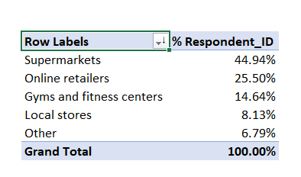
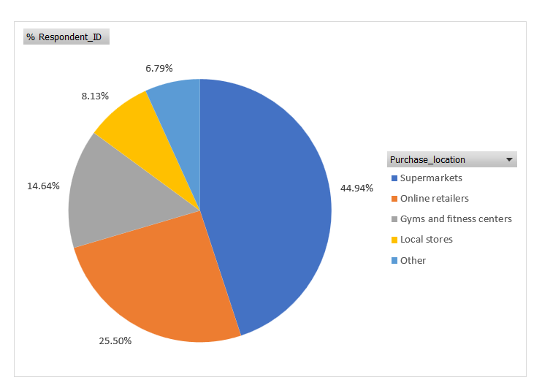
Purchase Behavior
Supermarkets are the most common choice among consumers to buy energy drinks.

Slide 13
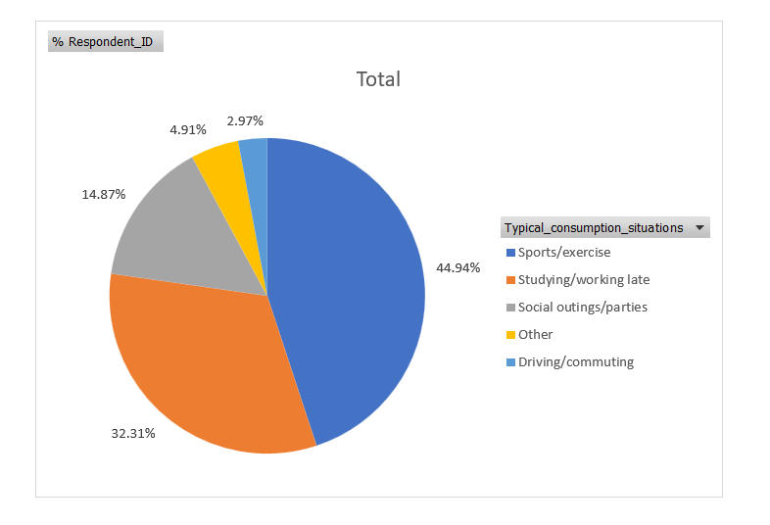
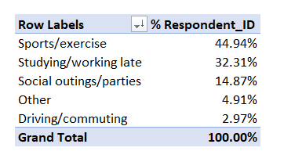
Purchase Behavior
Sports/exercise Studying/working late are the main reasons for consuming energy drinks.

Slide 14
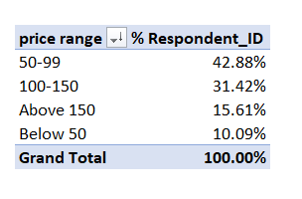
Purchase Behavior
70 % of respondent buy drinks between price range of 50 – 150 RS .

Slide 15
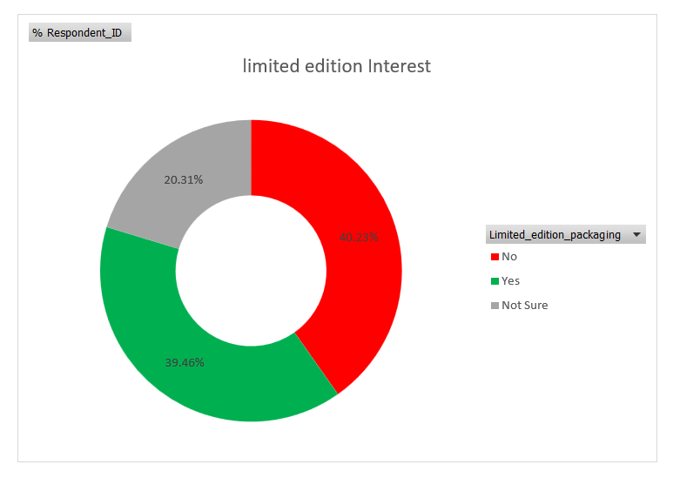
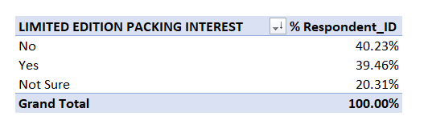
Purchase Behavior
40 % respondent are not Interested in limited edition packing while almost 40 % are Interested

Slide 16
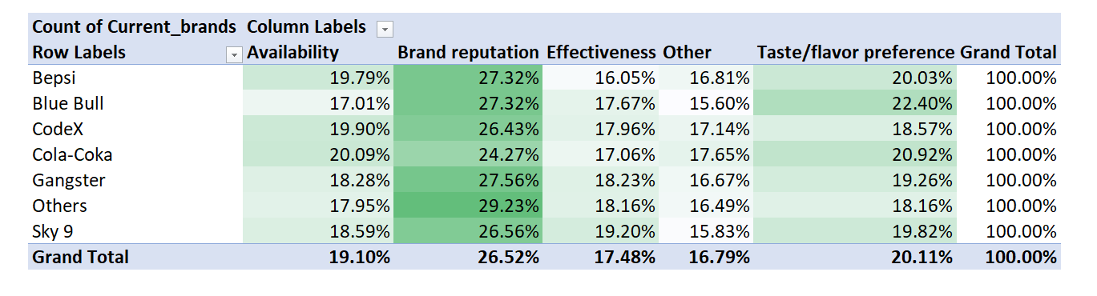
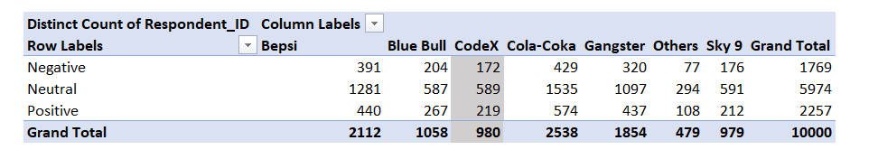
Product Development
Branding Reputation plays a major role in choosing which brand to pick by respondent
Out of 980 respondents of CodeX, only 219 have a positive brand perception.

Slide 17
What immediate improvements can we bring to the product?
Branding
Availability
Caffeine is the most expected ingredient followed by the Vitamins in energy drinks..
Improve positive response rate
Branding

Slide 18
What should be the ideal price of our product?
The price range expected by consumers lies between 50 to 150.
Where as 40 % of the consumers expect price between 50 to 99

Slide 19
What kind of offers and discounts we can run?
We can provide offers on buying the pack of cans at a cheaper cost
We can also run special discounts on festivals
We should also run campaigns on all major cities providing free samples and tasting to increase brand awareness

Slide 20
What kind of marketing campaigns we can run?
We got to know that online ads are the most effective way in letting consumers know about the brand and it is cost effective as well.
So we should increase running ads on facebook, Instagram & google as well.
And also increase budget for Social Media Influencers since more than 70 % of consumers are below 30 years of age so means all of them are on social media

Slide 21
Who can be a brand ambassador, and why?
Bhuvan Bum – People love him and has a huge following of over 19 million on Instagram.
Almost everyone of age less than 30 knows him
Prajakta koli – She is top female social media influencer in india and fitness enthusiast. She has very loyal following and could be a female face for our brand
WE can also Tie-up with other influencers as well
We can do lot of marketing by choosing them instead of some big film Actor. It will save us big money and all social media influncers are very much active.
Will promote our brand very well.

Slide 22
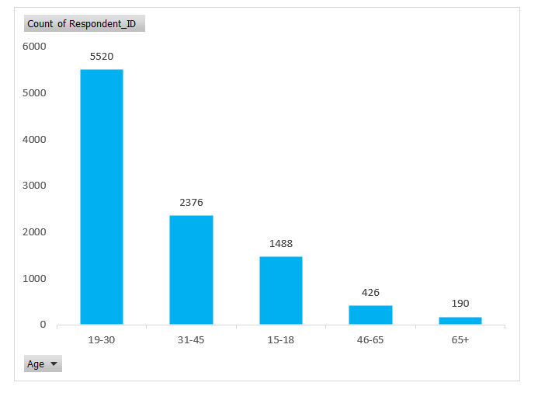
Who should be our target audience, and why?
our consumers are mostly between the ages of 15 to 30.
From this survey, the count shows that 70% of consumers are youth.

Slide 23
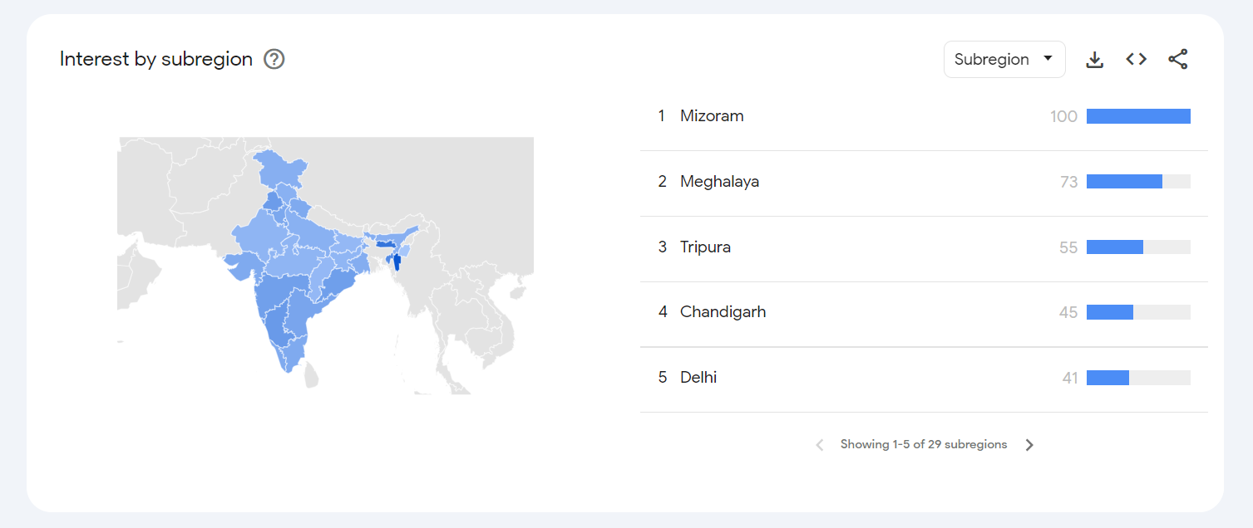
Additionally, I would like to share one more insight to target more cities. These are the stats of Google Trends from the past 12 months about the “Energy Drinks” topic
Mizoram, Meghalya, Tripura , Chattisgarh & Delhi are the cities where searches are done maximum for energy drinks.
So we should focus on expanding our business there.

Slide 24

Should Focus more on branding
online ads are the most effective for our business
Summary
70% of consumers are youth.
Age between 15to 30
The price range should be between 50 to 150.

Slide 25
Mizoram, Meghalya, Tripura , Chattisgarh & Delhi are the cities where we should look to expand our Business
Summary
Supermarkets are the most common choice to buy energy drinks.
Need to increase availability
Out of 980 respondent, negative feedback is by 172
And positive by just 219
Need to increase positive Response

Slide 26

Thank you!
ANY QUESTIONS?

